Slide 1




PIXTREAM
Create, Engage & Share
We are glad to present our project entitled ‘Pixtream’, prepared as part of our Mini project. It is a mini social media web application designed for sharing pots and connecting users through posts, likes, comments, and messages
Sain Saburaj
MCA23

Slide 2



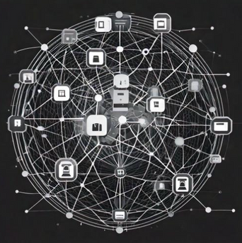


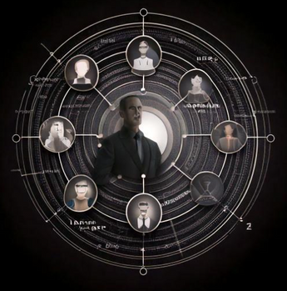
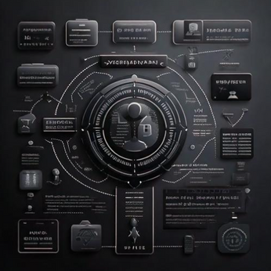

ABOUT
OUR SOFTWARE
What is Pixtream?
Pixtream is a mini social media platform designed for users to share photos and connect with friends and followers. It emphasizes user engagement and personalized experiences through tailored content and recommendations.
Pixtream offers:
Uploading and sharing posts,
Liking, commenting, and saving content
Following and unfollowing users Direct messaging for seamless communication
Users receive dynamic suggestions for people to follow and posts to view based on their interests and interactions. This ensures a unique and engaging experience tailored to individual preferences.
Admin play a crucial role in maintaining a safe environment by managing user complaints and reports. Users can report inappropriate content and block users, ensuring a respectful community.

Slide 3
OUR
PROJECT
1
PIXTREAM
Pixtream is a social media platform that allows users to share posts, connect with others, and engage with personalized content based on their interests.
2
DYNAMIC SUGGESTIONS
Algorithms can suggest users dynamically by comparing the current user's interests with other users and prioritize those with the highest overlap in interests or activities.
3
ADMIN CONTROLLED
Admin ensures the smooth functioning of the platform by managing key administrative functions.

Slide 4
SOFTWARE
OBJECTIVES
1
Facilitate User Interaction: Enable users to easily share posts, follow others, and engage with content through likes, comments, and messaging.
2
Dynamic Experience: Provide dynamic content and user suggestions based on individual interests and preferences.
3
Community Moderation: Ensure a safe environment by managing user complaints and reports.
4
Scalability and Simplicity: Build a lightweight, scalable platform that remains user-friendly while supporting future feature expansions

Slide 5


SYSTEM
USERS
There are mainly 2 users in this web application.
They are admin and users.
ADMIN
USER
The admin can manage user complaints and reports, review and approve reports of misconduct, restrict or delete user accounts based on violations, and handle platform-wide issues.
The users are the core participants who can create profiles, upload posts, like, comment, share, and save posts. They can follow or unfollow other users, send and receive messages, and block users if necessary.

Slide 6
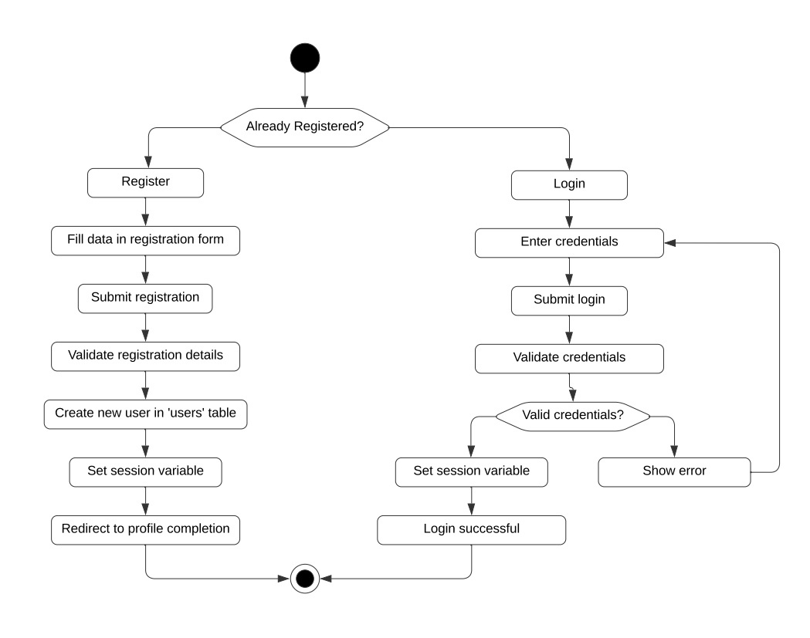

ACTIVITY
DIAGRAM
USER
No
Yes
Yes
No
USER REGISTRATION, LOGIN

Slide 7

ACTIVITY
DIAGRAM - USER
USER REGISTRATION, LOGIN
In Pixtream, the login and registration processes are designed to provide users with a seamless entry into the platform while ensuring their information is secure. During registration, new users create an account by providing essential details such as their name, username, email address, and password. This information is used to establish their unique profile on the platform. Upon successful registration, users receive a confirmation, granting them access to all features of Pixtream. The login process requires users to enter their registered username and password, allowing them to authenticate their identity and access their profiles. This streamlined login and registration system ensures that users can easily join the community and engage with the platform while maintaining their account's security.

Slide 8
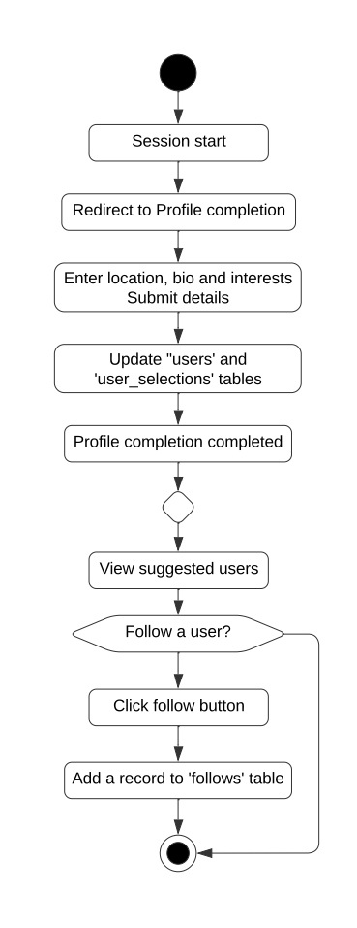


ACTIVITY
DIAGRAM - USER
CREATE PROFILE, SELECT INTERESTS, FOLLOW USERS
In Pixtream, users begin their journey by creating a personalized profile that includes essential information such as their name, bio, profile picture, and location, allowing them to express their identity on the platform. After the registration process, users are prompted to select their interests from a curated list, which helps tailor their experience by influencing the content and user suggestions they receive. Once their profiles are set up, users can connect with others by following them, enabling a social network of updates and interactions. They also have the flexibility to unfollow users at any time, ensuring they maintain a feed that reflects their preferences and interests. This combination of profile creation, interest selection, and social connectivity fosters a dynamic and engaging environment for users on Pixtream.
No
Yes

Slide 9
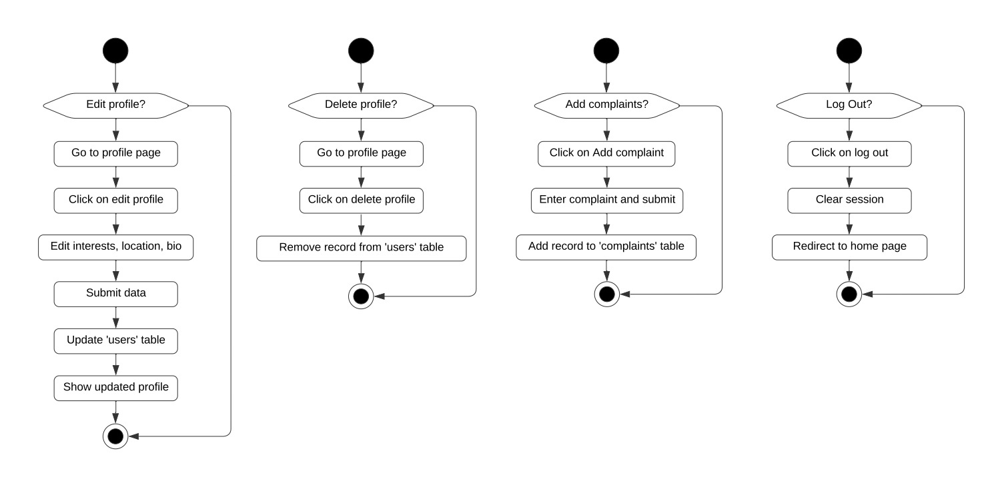
ACTIVITY
DIAGRAM - USER
No
No
Yes
Yes
EDIT, DELETE USER PROFILE

Slide 10


ACTIVITY
DIAGRAM - USER
EDIT, DELETE USER PROFILE
In Pixtream, users have the ability to edit and delete their profiles, providing them with full control over their personal information and online presence. The edit profile feature allows users to update their details, such as their bio, profile picture, and location, enabling them to reflect changes in their lives or preferences. This functionality ensures that their profile remains current and accurately represents them within the community. If a user decides to leave the platform or no longer wishes to maintain their account, they can opt to delete their profile. This action removes their account and all associated data from Pixtream, ensuring their privacy and giving them a clean exit from the platform. The process for both editing and deleting profiles is designed to be straightforward and user-friendly, allowing users to manage their online presence with ease and confidence.

Slide 11
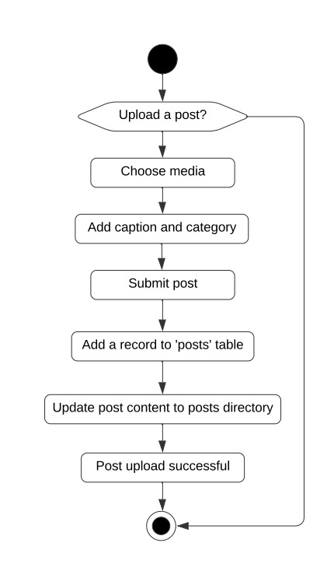

ACTIVITY
DIAGRAM - USER
No
Yes
ADD NEW POSTS
In Pixtream, users can easily add posts to share their thoughts, experiences, or moments with their followers. The process begins with uploading media, where users can select media from their device and accompany them with a caption that provides context or insight into the content. Additionally, users can categorize their posts by selecting relevant tags, making it easier for others to discover and engage with their content. Once shared, these posts become visible in the feeds of followers, who can interact by liking, commenting, or sharing the posts further. This functionality not only encourages user expression but also promotes engagement within the community, allowing users to connect over shared interests and experiences through their visual storytelling.

Slide 12
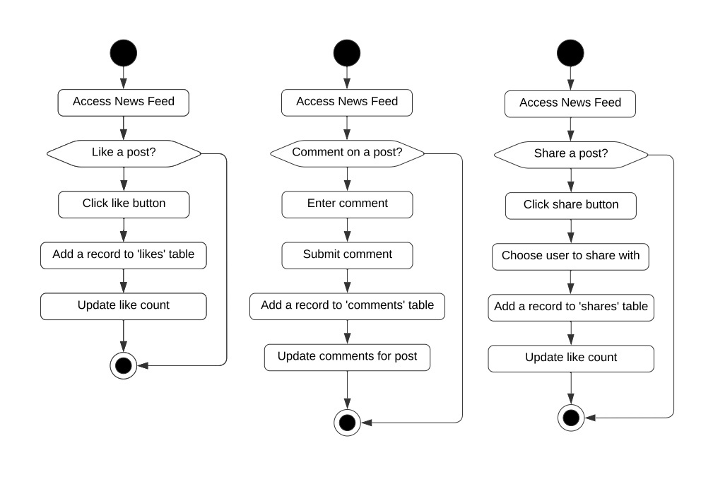
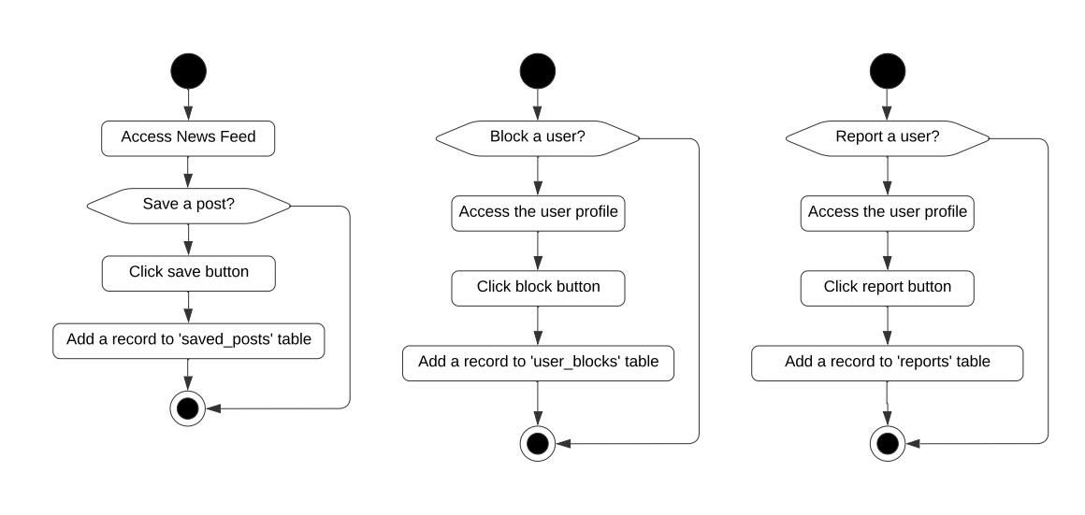
ACTIVITY
DIAGRAM - USER
No
No
No
No
Yes
Yes
Yes
Yes
LIKE, SHARE, COMMENT, SAVE

Slide 13




ACTIVITY
DIAGRAM - USER
LIKE, SHARE, COMMENT, SAVE
In Pixtream, users can engage with content through various interactive features such as liking, sharing, commenting, and saving posts. When a user comes across a post they enjoy, they can express their appreciation by liking it, which not only boosts the visibility of the post but also encourages the creator. Additionally, users have the option to share posts with their followers or directly via messaging, expanding the reach of the content and fostering discussions beyond the original post. Comments enable users to engage in conversations around the posts, allowing them to provide feedback, ask questions, or simply express their thoughts. For posts that resonate particularly well, users can save them to a personal collection for easy access later, ensuring they can revisit their favorite content whenever they want. Together, these features enhance the interactive experience on Pixtream, promoting a vibrant community where users can connect and share their interests effectively.

Slide 14
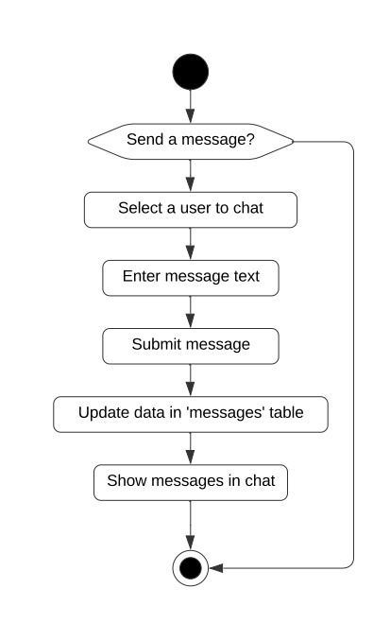

ACTIVITY
DIAGRAM - USER
No
Yes
MESSAGE USERS
In Pixtream, the chat feature facilitates direct messaging between users, enhancing communication and connection within the platform. This functionality allows users to send private messages to one another, enabling them to have one-on-one conversations without the need for public visibility. Users can share thoughts, experiences, or even links to posts directly through chat, making interactions more personal and immediate. The chat interface is designed for ease of use, allowing users to view conversation history. This real-time communication fosters deeper relationships among users, encouraging engagement and collaboration while helping to build a supportive community within Pixtream.

Slide 15
ACTIVITY
DIAGRAM - USER
No
No
No
Yes
Yes
Yes
BLOCK, REPORT USERS, ADD COMPLAINTS

Slide 16

ACTIVITY
DIAGRAM - USER
BLOCK, REPORT USERS, ADD COMPLAINTS
In Pixtream, the block and report features empower users to manage their interactions and maintain a safe and respectful environment. The block feature allows users to restrict specific individuals from viewing their profile, posts, or sending messages, giving them control over their social connections and protecting their experience on the platform. When a user feels threatened, harassed, or encounters inappropriate behavior, they can utilize the report feature to alert the platform's admin. This functionality enables users to submit complaints regarding specific content or users, prompting an investigation into the reported issue. The admin then reviews these reports to take appropriate actions, which may include warnings, restrictions, or account deletion. Together, these features ensure that users have the necessary tools to create a safe and enjoyable experience on Pixtream while fostering a supportive community.

Slide 17
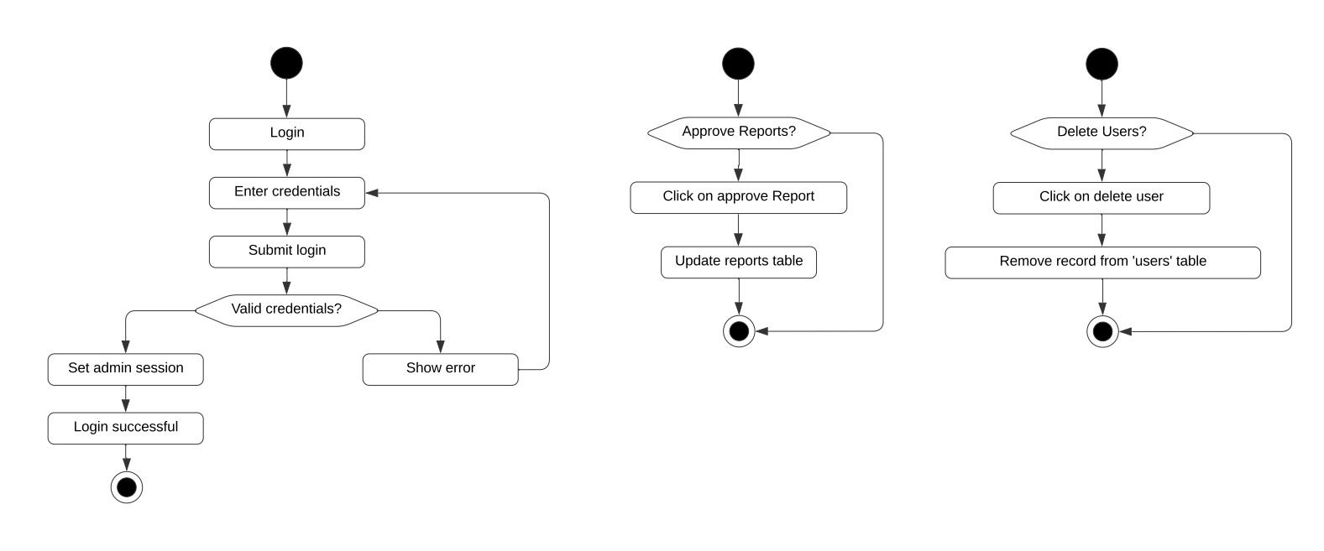
ACTIVITY
DIAGRAM - ADMIN
Yes
No
ADMIN LOGIN

Slide 18

ACTIVITY
DIAGRAM - ADMIN
ADMIN LOGIN
In Pixtream, the admin login process is designed to ensure secure access to administrative features and functionalities that are crucial for managing the platform. Admins enter their registered username and password on the login page, which authenticates their identity and grants them access to the admin dashboard. This dashboard provides tools for overseeing user activity, handling complaints and reports, moderating content, and managing user accounts. The admin login system incorporates security measures, such as encrypted passwords and possibly two-factor authentication, to protect sensitive administrative functions from unauthorized access. Once logged in, admins can efficiently monitor the platform, enforce community guidelines, and maintain a safe and enjoyable environment for all users.

Slide 19
ACTIVITY
DIAGRAM - ADMIN
No
Yes
ADMIN APPROVAL

Slide 20

ACTIVITY
DIAGRAM
ADMIN APPROVAL
In Pixtream, the admin plays a crucial role in maintaining platform integrity through the approval and complaints processes. When users report inappropriate behavior or content, the admin receives these reports for review and assessment. They evaluate the details and context surrounding each case, determining whether to approve actions like temporary suspensions, or permanent deletions of offending accounts. The admin addresses the complaints added by the users, ensuring that user feedback is taken seriously and that the platform remains a safe and enjoyable space for all users. By actively managing both approvals and complaints, the admin fosters a supportive environment and helps uphold community guidelines.

Slide 21
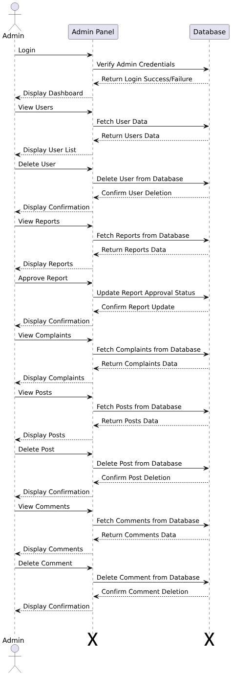
SEQUENCE
DIAGRAM
ADMIN
ADMIN ACTIONS

Slide 22
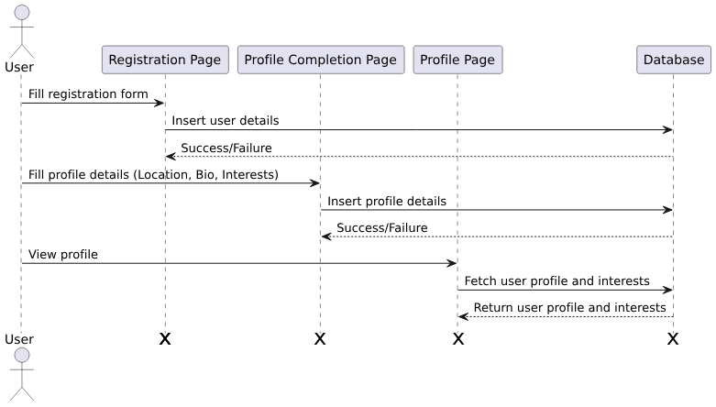
SEQUENCE
DIAGRAM - USER
USER ACTIONS

Slide 23
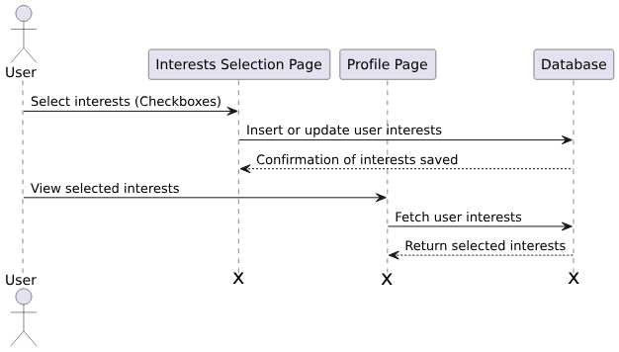
SEQUENCE
DIAGRAM - USER
SELECTION OF USER INTERESTS

Slide 24
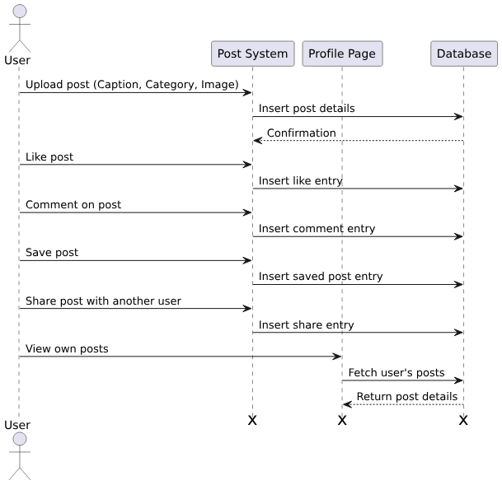
SEQUENCE
DIAGRAM
USER
INTERACTION WITH POSTS

Slide 25
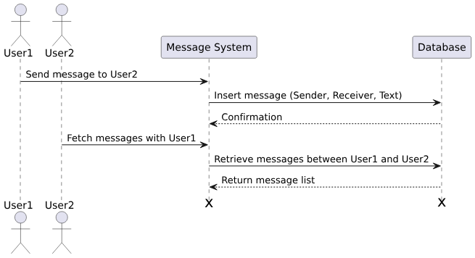
SEQUENCE
DIAGRAM - USER
MESSAGING

Slide 26
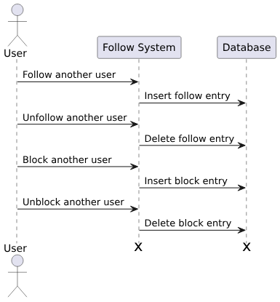
SEQUENCE
DIAGRAM - USER
FOLLOW-UNFOLLOW
BLOCK-UNBLOCK

Slide 27
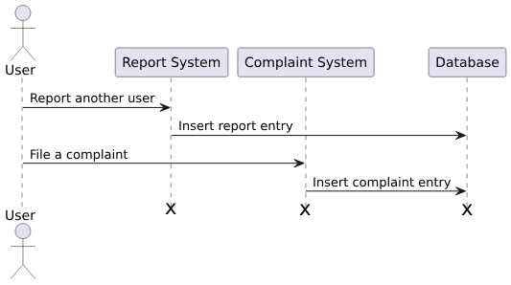
SEQUENCE
DIAGRAM - USER
REPORT USER
SUBMIT COMLAINTS

Slide 28
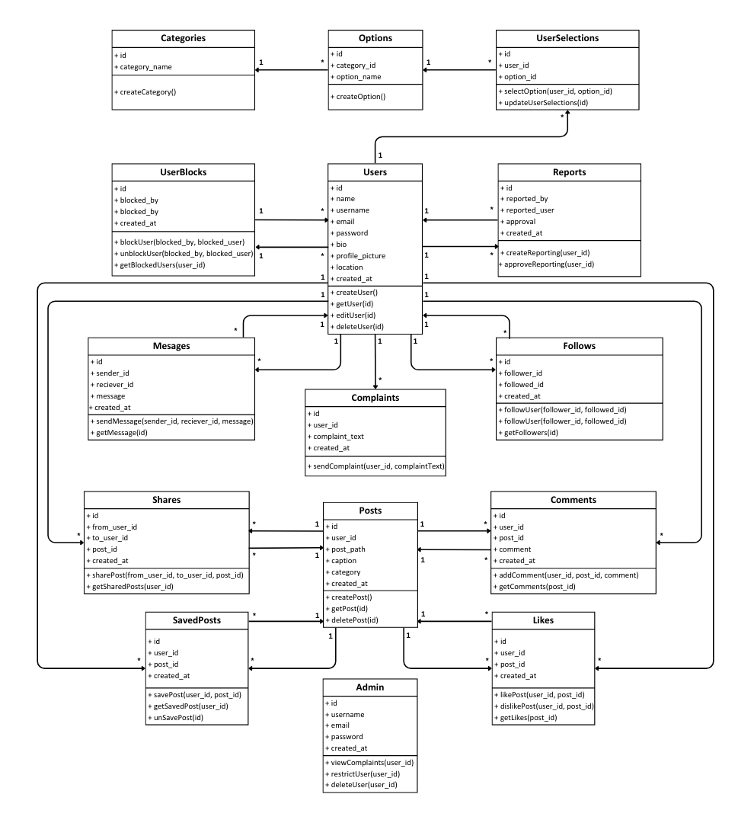
CLASS
DIAGRAM

Slide 29
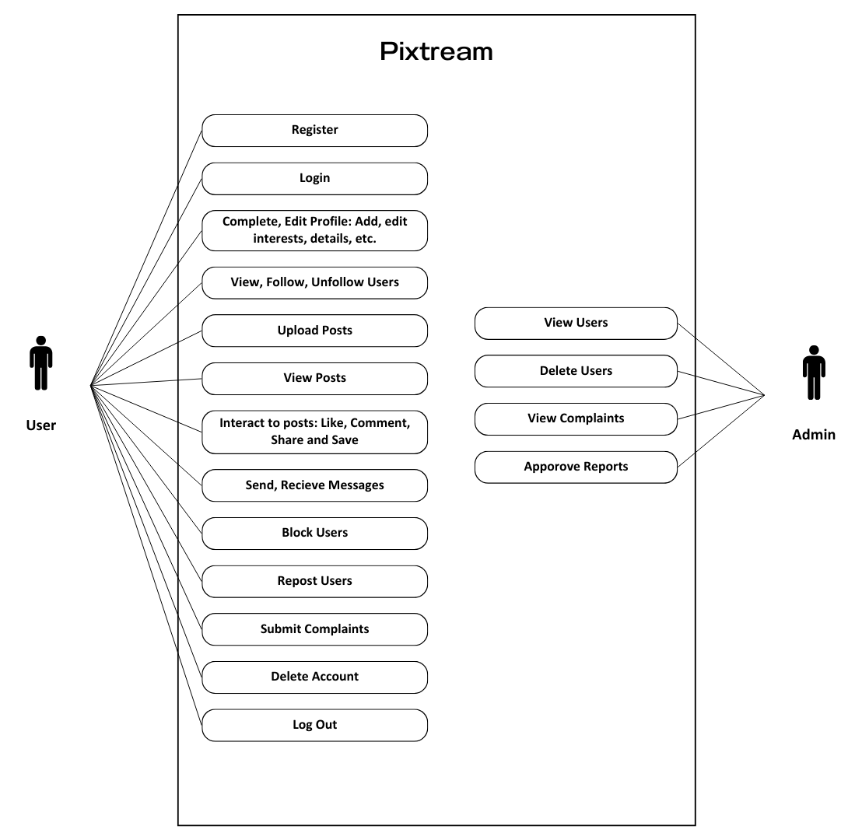
USE CASE
DIAGRAM
Main actors: Admin, User

Slide 30
DATABASE
CONTENTS
Users Table
Column Name | Data Type | Constraints | Description
id | BIGINT | AUTO_INCREMENT, PRIMARY KEY | Unique user identifier
name | VARCHAR(255) | NOT NULL | Full name of the user
username | VARCHAR(255) | UNIQUE, NOT NULL | Unique username of user
email | VARCHAR(255) | UNIQUE, NOT NULL | Email address of user
password | VARCHAR(255) | NOT NULL | Password for user login
bio | TEXT | NULL | Short bio of the user
profile_picture | VARCHAR(255) | NULL | Path to profile picture
location | VARCHAR(255) | NULL | User's location
created_at | TIMESTAMP | DEFAULT CURRENT_TIMESTAMP | Account creation timestamp

Slide 31
DATABASE
CONTENTS
Posts Table
Column Name | Data Type | Constraints | Description
id | BIGINT | AUTO_INCREMENT, PRIMARY KEY | Unique post identifier
user_id | BIGINT | FOREIGN KEY | User who created the post
post_path | VARCHAR(255) | NOT NULL | Path to the post content
caption | LONGTEXT | NULL | Caption or description of post
category | SET | NOT NULL | Category of the post
created_at | TIMESTAMP | DEFAULT CURRENT_TIMESTAMP | Post creation timestamp

Slide 32
DATABASE
CONTENTS
Likes Table
Comments Table
Column Name | Data Type | Constraints | Description
id | BIGINT | AUTO_INCREMENT, PRIMARY KEY | Unique like identifier
user_id | BIGINT | FOREIGN KEY | User who liked the post
post_id | BIGINT | FOREIGN KEY | Post that was liked
created_at | TIMESTAMP | DEFAULT CURRENT_TIMESTAMP | Like timestamp
Column Name | Data Type | Constraints | Description
id | BIGINT | AUTO_INCREMENT, PRIMARY KEY | Unique comment identifier
user_id | BIGINT | FOREIGN KEY | User who made the comment
post_id | BIGINT | FOREIGN KEY | Post on which commented
comment | TEXT | NOT NULL | Content of the comment
created_at | TIMESTAMP | DEFAULT CURRENT_TIMESTAMP | Comment creation timestamp

Slide 33
DATABASE
CONTENTS
Shares Table
Saved_Posts Table
Column Name | Data Type | Constraints | Description
id | BIGINT | AUTO_INCREMENT, PRIMARY KEY | Unique share identifier
from_user_id | BIGINT | FOREIGN KEY | User sharing the post
to_user_id | BIGINT | FOREIGN KEY | User receiving the post
post_id | BIGINT | FOREIGN KEY | Post being shared
created_at | TIMESTAMP | DEFAULT CURRENT_TIMESTAMP | Share creation timestamp
Column Name | Data Type | Constraints | Description
id | BIGINT | AUTO_INCREMENT, PRIMARY KEY | Unique saved post identifier
user_id | BIGINT | FOREIGN KEY | User who saved the post
post_id | BIGINT | FOREIGN KEY | Post that was saved
created_at | TIMESTAMP | DEFAULT CURRENT_TIMESTAMP | Save creation timestamp

Slide 34
DATABASE
CONTENTS
Follows Table
Messages Table
Column Name | Data Type | Constraints | Description
id | BIGINT | AUTO_INCREMENT, PRIMARY KEY | Unique follow identifier
follower_id | BIGINT | FOREIGN KEY | User who follows
followed_id | BIGINT | FOREIGN KEY | User being followed
created_at | TIMESTAMP | DEFAULT CURRENT_TIMESTAMP | Follow creation timestamp
Column Name | Data Type | Constraints | Description
id | BIGINT | AUTO_INCREMENT, PRIMARY KEY | Unique message identifier
sender_id | BIGINT | FOREIGN KEY | Sender of the message
receiver_id | BIGINT | FOREIGN KEY | Receiver of the message
message | TEXT | NOT NULL | Content of the message
created_at | TIMESTAMP | DEFAULT CURRENT_TIMESTAMP | Message creation timestamp

Slide 35
DATABASE
CONTENTS
User_Blocks Table
Reports Table
Column Name | Data Type | Constraints | Description
id | BIGINT | AUTO_INCREMENT, PRIMARY KEY | Unique block identifier
blocked_by | BIGINT | FOREIGN KEY | User who blocked another
blocked_user | BIGINT | FOREIGN KEY | Blocked user
created_at | TIMESTAMP | DEFAULT CURRENT_TIMESTAMP | Block creation timestamp
Column Name | Data Type | Constraints | Description
id | BIGINT | AUTO_INCREMENT, PRIMARY KEY | Unique report identifier
reported_by | BIGINT | FOREIGN KEY | User reporting another
reported_user | BIGINT | FOREIGN KEY | User being reported
approval | BOOLEAN | DEFAULT FALSE | Approval status of report
created_at | TIMESTAMP | DEFAULT CURRENT_TIMESTAMP | Report creation timestamp

Slide 36
DATABASE
CONTENTS
Admin Table
Complaints Table
Column Name | Data Type | Constraints | Description
id | BIGINT | AUTO_INCREMENT, PRIMARY KEY | Unique admin identifier
username | VARCHAR(255) | UNIQUE, NOT NULL | Admin's username
email | VARCHAR(255) | UNIQUE, NOT NULL | Admin's email address
password | VARCHAR(255) | NOT NULL | Admin's password
created_at | TIMESTAMP | DEFAULT CURRENT_TIMESTAMP | Admin creation timestamp
Column Name | Data Type | Constraints | Description
id | BIGINT | AUTO_INCREMENT, PRIMARY KEY | Unique complaint identifier
user_id | BIGINT | FOREIGN KEY | User filing the complaint
complaint_text | TEXT | NOT NULL | Content of the complaint
created_at | TIMESTAMP | DEFAULT CURRENT_TIMESTAMP | Complaint creation timestamp

Slide 37
DATABASE
CONTENTS
Categories Table
Options Table
Column Name | Data Type | Constraints | Description
id | BIGINT | AUTO_INCREMENT, PRIMARY KEY | Unique category identifier
category_name | VARCHAR(255) | NOT NULL | Name of the category
Column Name | Data Type | Constraints | Description
id | BIGINT | AUTO_INCREMENT, PRIMARY KEY | Unique option identifier
category_id | BIGINT | FOREIGN KEY | Category this option belongs to
option_name | VARCHAR(255) | NOT NULL | Name of the option

Slide 38
DATABASE
CONTENTS
User_Selections Table
Column Name | Data Type | Constraints | Description
id | BIGINT | AUTO_INCREMENT, PRIMARY KEY | Unique selection identifier
user_id | BIGINT | FOREIGN KEY | User making the selection
option_id | BIGINT | FOREIGN KEY | Option selected by the user

Slide 39







USED
PLATFORM
1
FRONTEND
2
BACKEND
3
IDE
HTML5
PHP
VISUAL STUDIO CODE
CSS
MYSQL
BOOTSTRAP
JAVASCRIPT

Slide 40

WE
CONCLUDE
Thank you for your attention!
Pixtream is a mini social media platform designed for users to share photos, connect with friends, and engage with personalized content based on their interests. We aim to create a vibrant community where users can express themselves, interact meaningfully, and discover new connections.
Thank You!

Slide 41

Thank You!

